Slide 1

AISHWARYAA A [MBE 10]

Slide 2
INTRODUCTION
Disney+ Hotstar is an Indian subscription video-on-demand over-the-top streaming service owned by Digital18 a subsidiary of Viacom18 featuring domestic Indian film , television and sports content for India itself and its worldwide diaspora.
It also includes imported content from and serves Southeast Asia as well.
With content in 8 languages, spanning 15 TV channels, Disney+ Hotstar is home to some of the longest running, and highest rated TV content in the country.
Disney+ Hotstar can be streamed in India, Indonesia, Thailand, and Malaysia.
CEO of Hotstar : Sajith Sivanandan

Slide 3
THE INSIDE STORY !!!
Disney+ Hotstar set a world record for the highest concurrent viewership at 59 million during the ICC Men's Cricket World Cup 2023.
Disney+ Hotstar offers over 100,000 hours of content in 18 languages, including international and regional shows, movies, live sports, and Disney content.
Web App: Primarily based on HTML5, Javascript, and libraries like jQuery.
Content Delivery Network (CDN): Akamai is the CDN partner, ensuring fast and reliable content delivery across different regions
It is the leader in India's streaming market, with a 29% share.
In 2019, The Walt Disney Company acquired Star India, which led to the creation of Disney+ Hotstar.

Slide 4
SWOT ANALYSIS ..
STRENGTHS | WEAKNESSES | OPPORTUNITIES | THREATS
Strong content library (access to vast collections ) | Market saturation (crowded with competitors , challenge to maintain the position) | Expansion into new markets (where streaming is gaining popularity) | Intense competition
Brand recognition (globally recognized) | Regional Limitations | Enhancing user experience (invest in tech) | Changing consumer preferences
Diverse audience | Content licensing | Partnerships and collaborations | Regulatory challenges
Original Programming

Slide 5
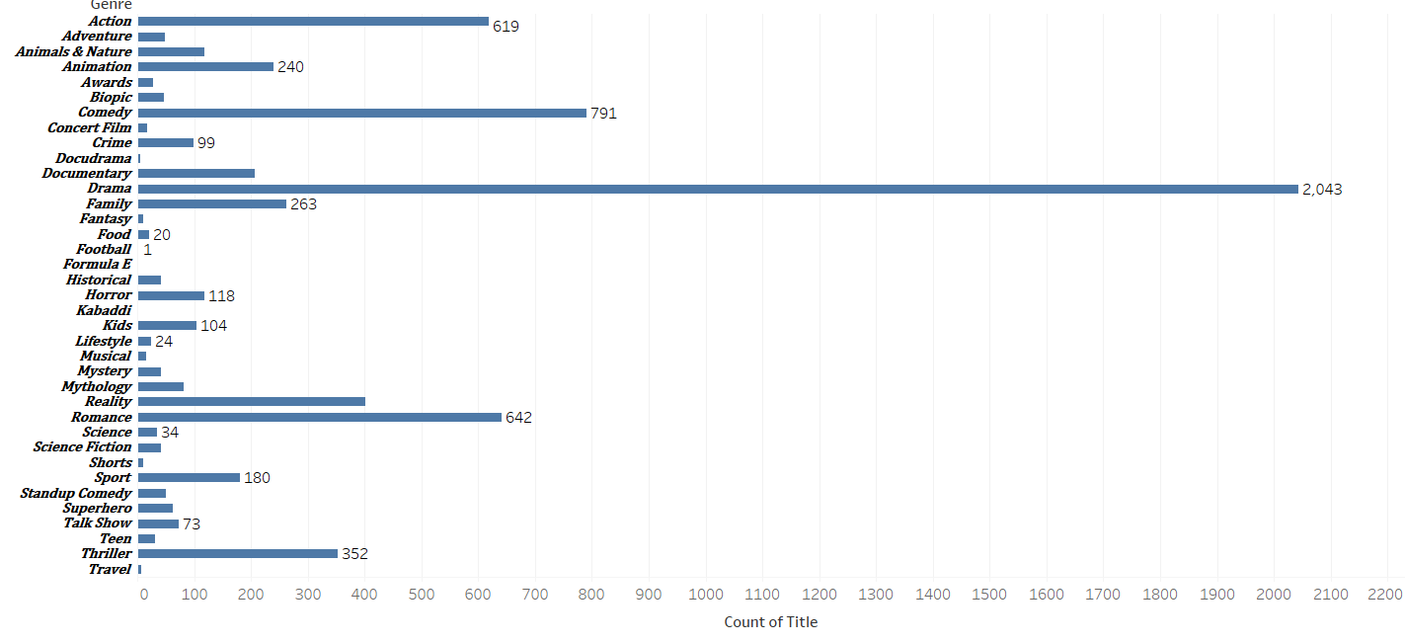
TASK 1: DISTRIBUTION OF MOVIES BY GENRE
FROM THIS WE CAN FIGURE IT OUT THAT DRAMA GENRE MOVIES TOPS AS IT HAS A TOTAL OF 2,043 MOVIES .
TOP 5 PLACES IS TAKEN UP BY
DRAMA (2,043)
COMEDY (791)
ROMANCE (642)
ACTION (619)
THRILLER (352)

Slide 6
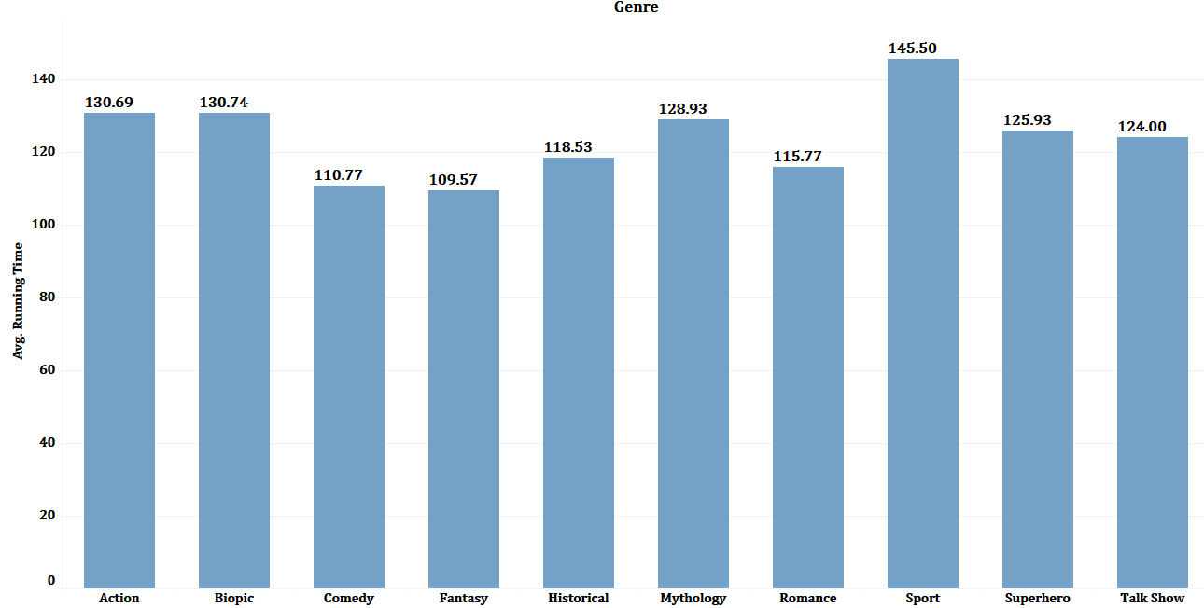
TASK 2 : AVERAGE RUNNING TIME BY GENRE
BASICALLY , IT IS CALCULATED SO THAT WE CAN HIGHLIGHT DIFFERENCES IN PACING AND WHICH TYPE GENRE GETS A HIGHEST VIEWS :
SPORTS
ACTION & BIOPIC
MYTHOLOGY
SUPERHERO
TALKSHOW

Slide 7
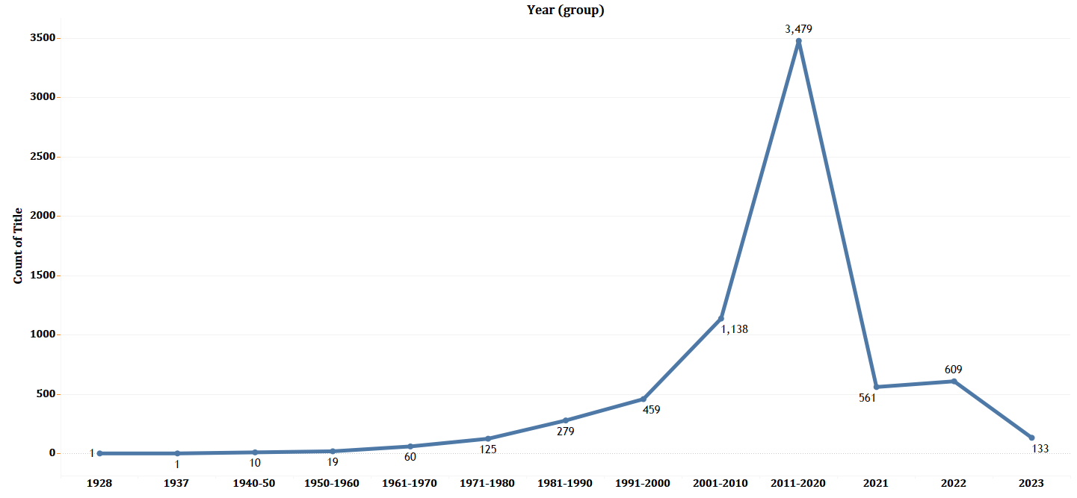
TASK 3 : MOVIES RELEASED EACH YEAR
EACH YEAR LOTS AND LOTS OF MOVIES GETS REALEASED AND IT VARIES ON VARIOUS YEARS
1. 2011- 2020(3,479) PEAKED HERE
2. 2001-2010(1,138) START PHASE
3. 2021 ( 561 ) LITTLE DROP
4. 2022 (609) AGAIN A START
5.1981 -1990 (279) REALIZATION PHASE
AS A RESULT IT KEEPS ON FLUCTUATING

Slide 8
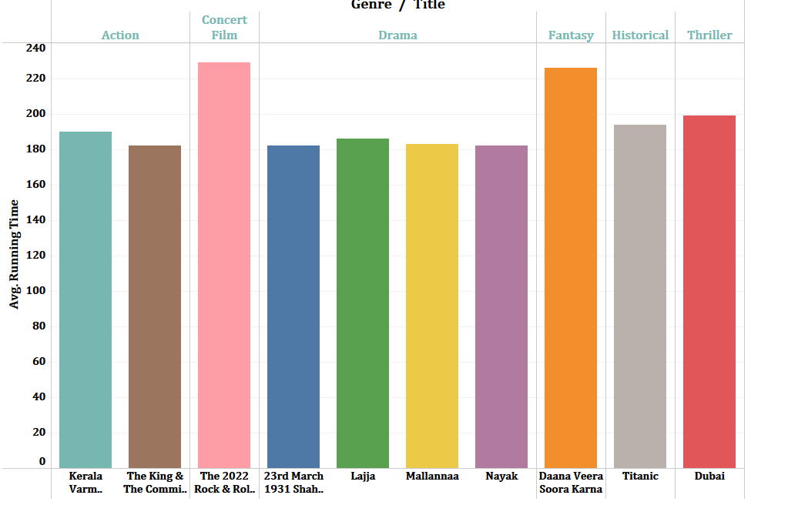
TASK 4 : TOP 10 LONGEST MOVIES
MOVIES HAVE BEEN SEGREGATED ACC TO THEIR GENRE & AVG RUNNING TIME IS ALSO TAKEN IN CONSIDERATION
FROM THIS WE CAN FIND THE TOP 10 LONGEST MOVIES IN WHICH
1.CONCERT GENRE HAS LONGEST RUNNING TIME (229.00)
2.FANTASY GENRE(226.00)
3.THRILLER (199.00)

Slide 9
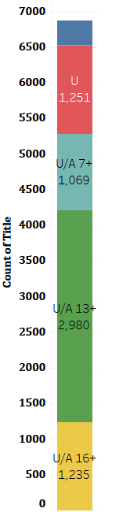
TASK 5: MOVIES BY AGE RATING
ACCORDING TO CBFC (CENTRAL BOARD OF FILM CERTIFICATION ),AGE RATING IS BASICALLY PROVIDED TO GUIDE ON APPROPRIATE AUIDENCE BASED ON CONTENT
1.U (UNIVERSAL ) SUITABLE FOR ALL AGES (1,251)
2. U/A 7+ (SUITABLE FOR CHILDREN ABOVE 7 )(1,069)
3. U/A 13+ (SUITABLE FOR ABOVE 13YRS)(2,980)
4. U/A16+ (SUITABLE FOR ABOVE 16YRS )(1,235)
5. A (ADULT) (338)

Slide 10
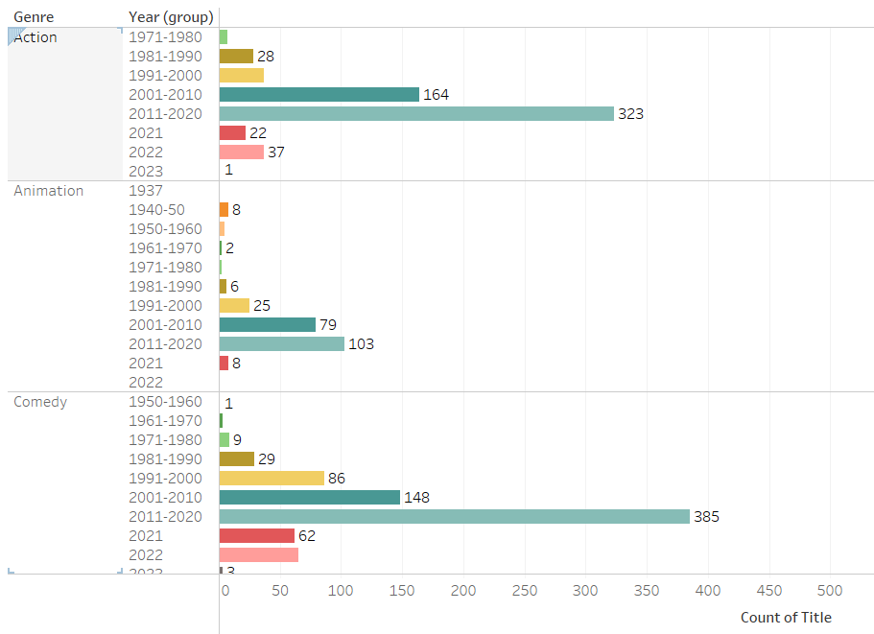
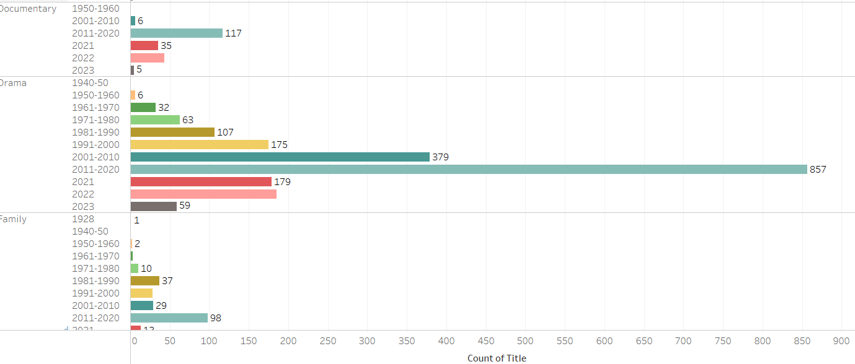
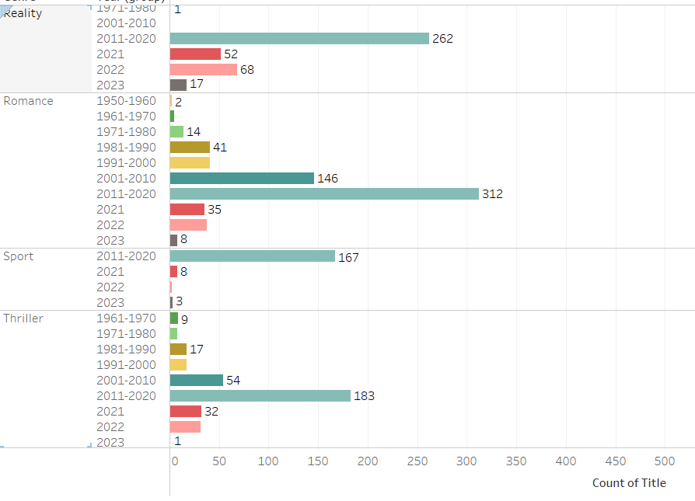
TASK 6 :COUNT OF MOVIES BY YEAR AND GENRE
COUNT OF MOVIES VARIES BY THE INTERST OF FILM MAKERS OR AUIDENCE
AT THE END OF ANALYSIS ALL MOVIESHAVE PEAKED IN YR GROUP (2011-2020)
ACTION (323) ANIMATION(103)
COMEDY (385) DOCUMENTARY(117)
DRAMA (857) FAMILY (98)
REALITY(262) ROMANCE (312)
SPORT(167) THRILLER (183)

Slide 11
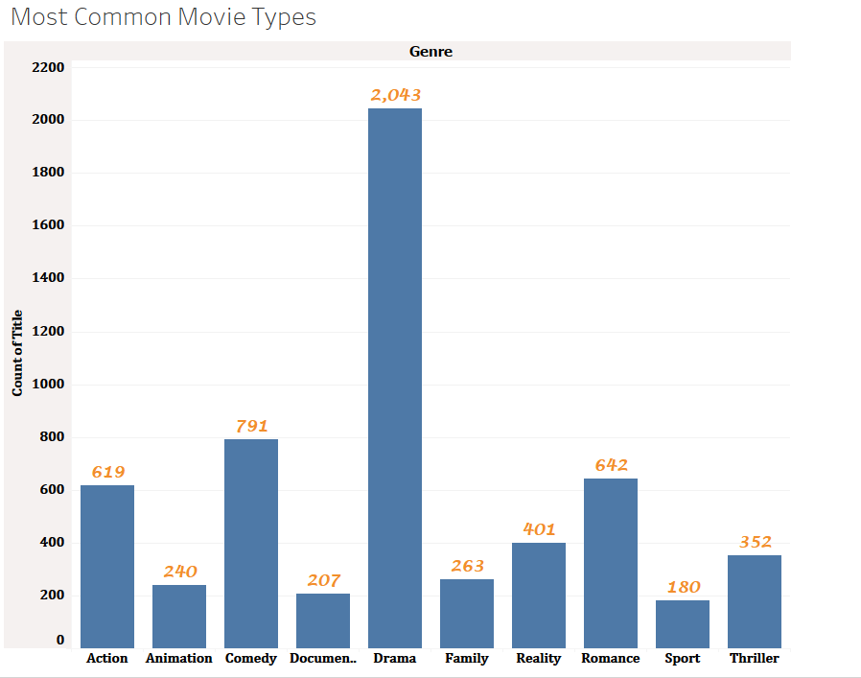
TASK 7: MOST COMMON MOVIE TYPES
COMMOM TYPES ARE FOUND OUT ON VARIOUS ASPECTS LIKE THEMES, PLOT, TONE & MOOD, CHARACTER TYPES, VISUALS
DRAMA (2,043)
COMEDY
ROMANCE
ACTION
DOCUMENTARY (207)

Slide 12
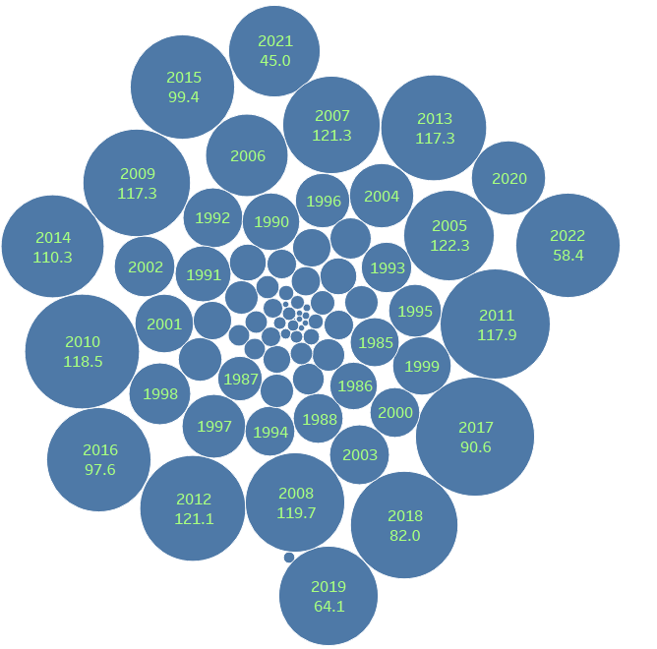
TASK 8 : CORRELATION B/W RUNNING TIME & YEAR
BASICALLY , CORRELATION CAN PROVIDE A GREATER INSIGHTS INTO SEVERAL TRENDS AND PATTERNS IN FILM INDUSTRY LIKE INDUSTRY TRENDS , AUIDENCE TRENDS , CONTENT GENRE EVOLUTION , CULTURAL SHIFTS
BY CALCULATING THIS REASEARCHES AND INDUSTRY PROFESSIONALS CAN BETTER UNDERSYAND THE DYNAMICS OF FILM MAKING AND ITS RELATIONSHIP TO AUIDENCE ENGAGEMENT AND PREFERENCES .

Slide 13
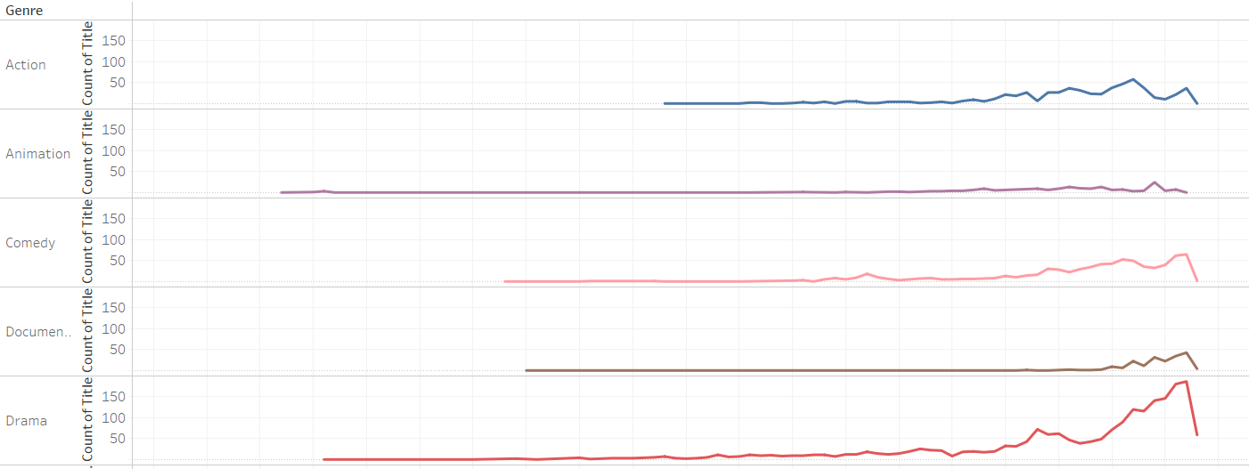
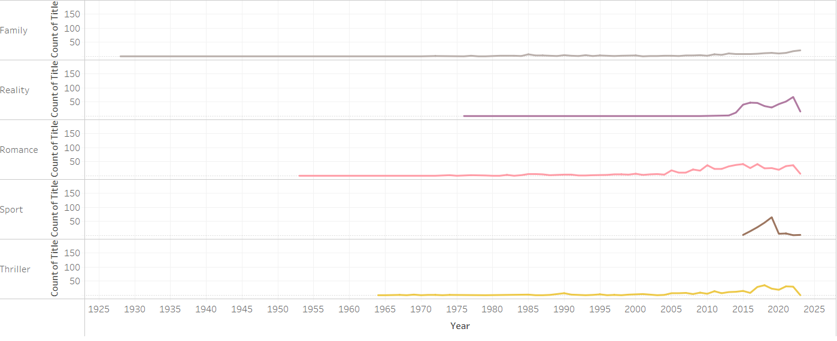
TASK 9: GENRE POPULARITY OVER TIME
GENRE POPULARITY CHANGES OVER A PERIOD OF TIME AND IT VARIES YEAR BY YEAR AND THIS CHANGE CAN BE IDENTIFIED BY USING THE LINE CHART AS IT SHOWS HOW IT CHANGES IN THE FLOW MAYE BE BECOZ OF INFLUENCE OF POPULAR MEDIA , NOSTALGIA .
THESE DYNAMICS CREATE A CONSTANTLY EVOLVING LANDSCAPE IN ENTERTAINMENT AND LITERATURE

Slide 14
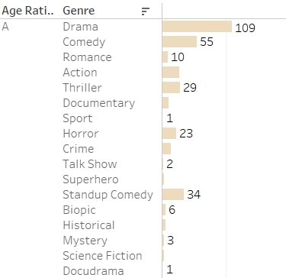
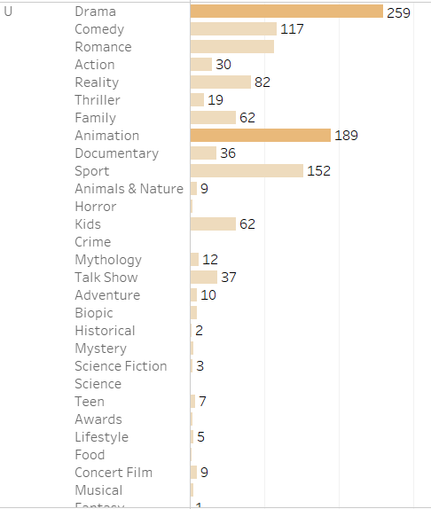
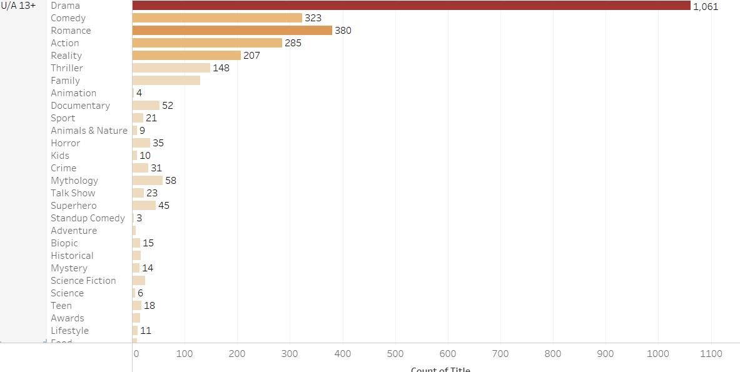
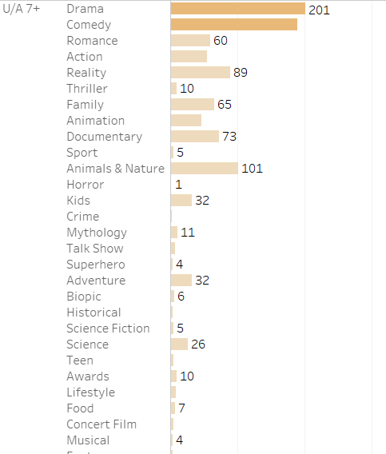
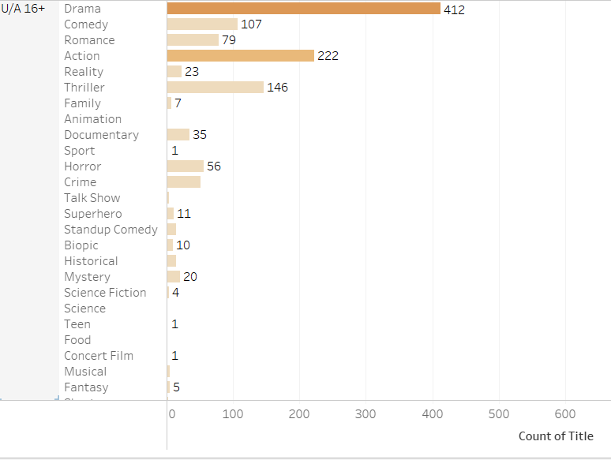
TASK 10 :MOVIES BY GENRE AND AGE RATING
EACH RATING HAS A HIGHEST GENRE AND THAT IS DRAMA GENRE LETS US SEE
1.U( 259)
2.U/A 7+ (201)
3. U/A 13 + (1,061)
4. U/A 16+ (412)
5 . A (109)

Slide 15
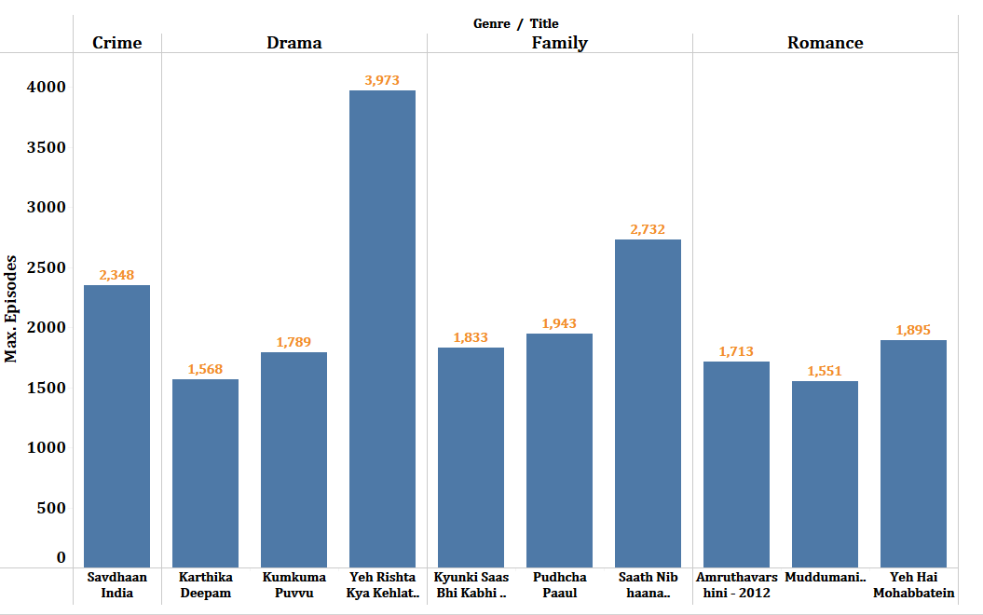
TASK 11 : MOVIES WITH MAXIMUM EPISODES
TO FIND THE MAX EPISODES OF MOVIE I HAVE DIVIDED THE MOVIES BY GENRE
1.DRAMA (3,973)
2.FAMILY (2,732)
3.CRIME (2,348)
4.DRAMA (1,568)

Slide 16
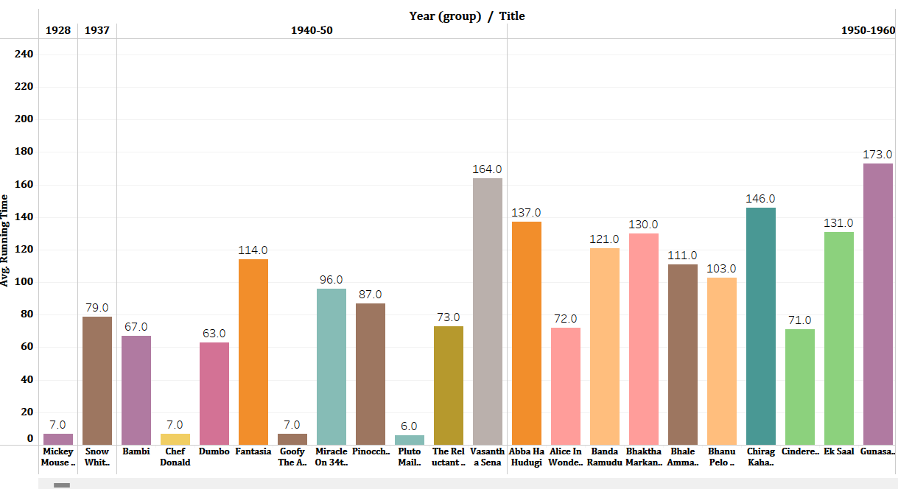
TASK 12 : DISTRIBUTION BY RUNNING TIME
THIS BAR CHART SHOWS HOW EACH MOVIES OR GENRE VARY GREATLY AS IT DEPENDS HOW THE AUIDENCE VIEW IT AND THAT’S THE RESULT THAT WE GET AS A HIGHEST VIEWS
TO MAKE IT SIMPLE & EASY I HAVE GIVEN A YEAR GROUP FILTER

Slide 17
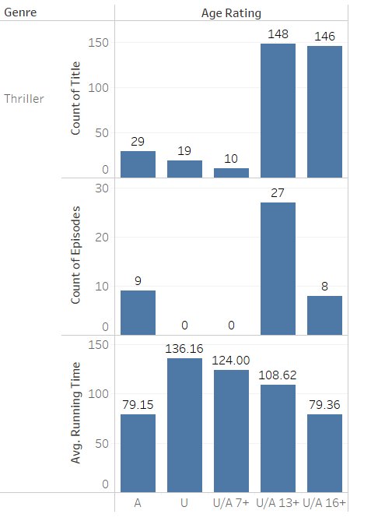
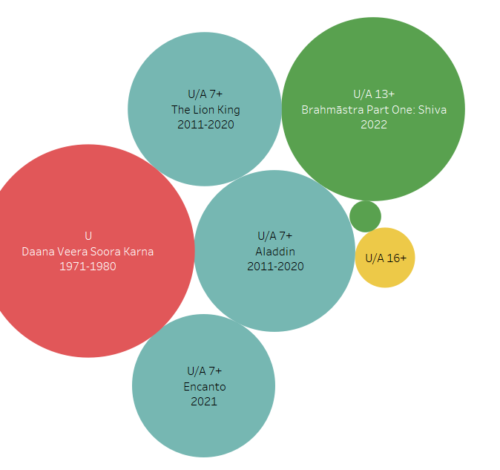
TASK 13 : ANALYSIS OF SPECIFIC GENRES
FANTASY GENRE
THRILLER GENRE

Slide 18
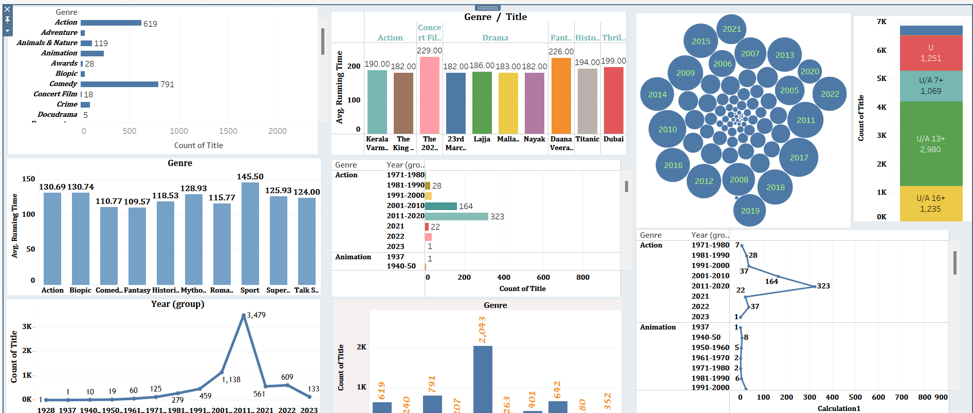
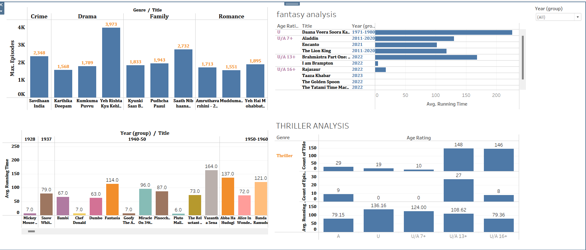
FOR THE ANALYSIS I HAVE USED @ TABLEAU SOFTWARE

Slide 19
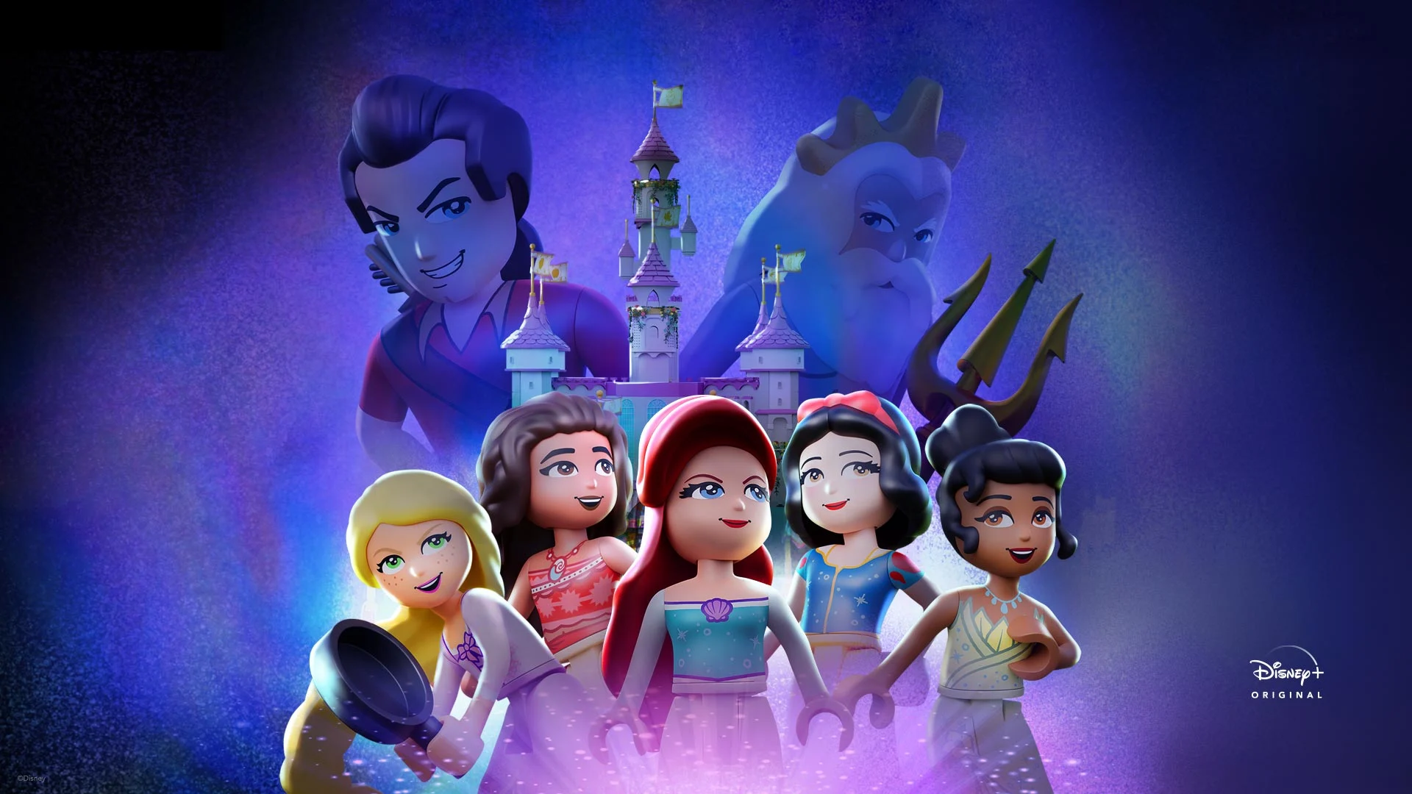
THE END !!

